Slide 1
Connecting Digital and Physical: Serial Communication between Arduino and p5.js
ITP Camp 2019
Yeseul Song
yeseul.com | pyeseul@gmail.com | @yeseulsong_

Slide 2

Notes:
There isn’t a common clock in asynchronous serial communication; instead, both devices keep time independently, and either send or listen for new bits of data at an agreed-upon rate.
In order to communicate, the two devices need to agree on a few things:
the rate at which data is sent and read
the voltage levels representing a 1 or a 0 bit

Slide 3
Connecting Digital and Physical
Example Projects
Arduino and Processing over Serial by Alex Corbi
Controlling model train with keyboard by Kushagra Keshari
My Projects
My very first ART with serial communication: Sleeping Guy (Arduino - Processing)
Etch-a-sketch
Re-coded
Illuminated Path

Slide 4
Connecting Digital and Physical
Any ideas what you would want to make with this?
Any projects you’re working on?
Input/Output can be almost anything!

Slide 5
Today, we’ll go over:
Serial Communication?
Serial Communication between Arduino and p5.js
Arduino to p5.js
Binary
Ascii
Multiple values
p5.js to Arduino
Binary
Ascii
Multiple values
Etch-a-sketch
Notes:
There isn’t a common clock in asynchronous serial communication; instead, both devices keep time independently, and either send or listen for new bits of data at an agreed-upon rate.
In order to communicate, the two devices need to agree on a few things:
the rate at which data is sent and read
the voltage levels representing a 1 or a 0 bit

Slide 6
Serial Communication?
Serial Communication between Arduino and p5.js
Arduino to p5.js
p5.js to Arduino
Etch-a-sketch

Slide 7
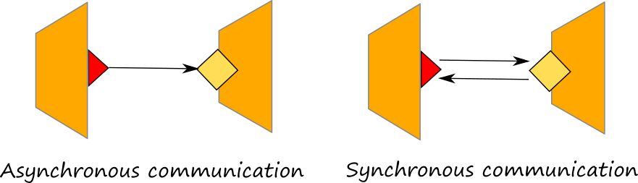
Asynchronous Communication
No common clock
Instead, both devices keep time independently, and either send or listen for new bits of data at an agreed-upon rate.
Notes:
One can send while the other is not listening

Slide 8
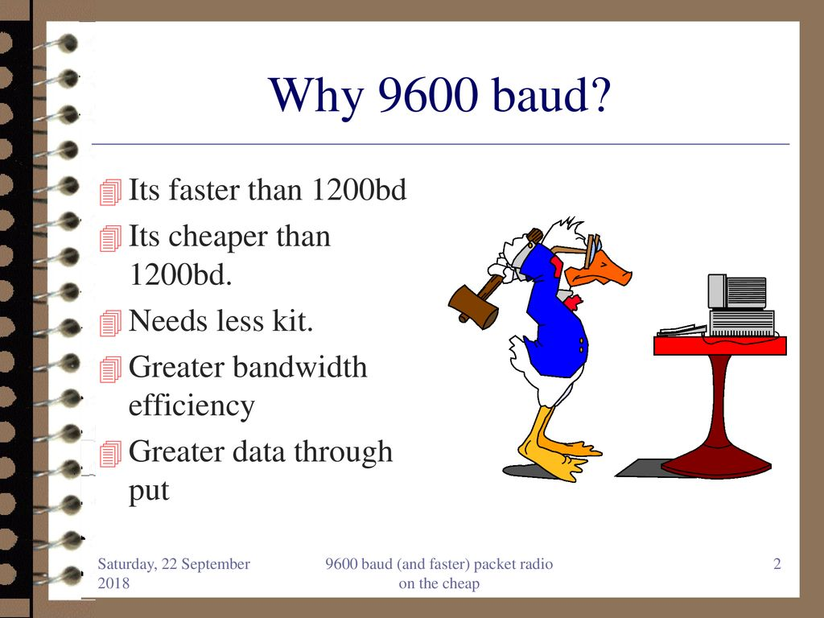

In Order to Communicate, the two devices need to agree on:
the rate at which data is sent and read
the voltage levels representing a 1 or a 0 bit
Notes:
Arduino, p5 - default 9600 baud (bits per second)

Slide 9
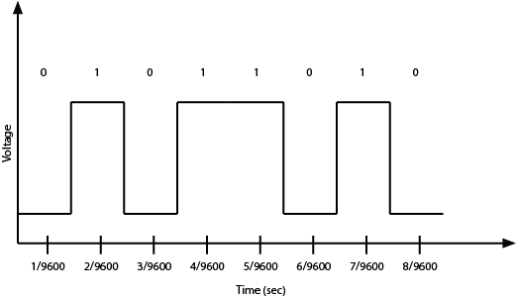
Data Transmission
True Logic
Inverted Logic
1 0 1 0 0 1 0 1
Notes:
1 can represent either high voltage or low voltage
True logic: TTL serial (serial communication)
Inverted logic: e.g., RS-232 (the standard serial protocol for most personal computers before USB)

Slide 10
Data Transmission
Imagine you’re sending ( ? ) with true logic...

Slide 11
Data Transmission
Imagine you’re sending 90 with true logic...

Slide 12
USB
Notes:
“USB is a complex protocol that can support many different classes of devices, from human interface devices (HID) like mice and keyboards to mass storage devices to cameras, and more. Because so many devices still use asynchronous serial communication, USB includes a Communications Device Class (CDC) that supports asynchronous serial communication. Devices that include a USB-to-serial converter will show up as serial ports to your computer when you plug them in. Many microcontroller boards, including the Arduino boards, include a USB-to-serial converter to communicate with your computer in this way. When you plug them in, any program that can read serial ports will list the connected Arduino in the list of serial ports.”
https://itp.nyu.edu/physcomp/lessons/serial-communication/serial-communication-the-basics/

Slide 13
Serial Buffer
Notes:
“UART stands for Universal Asynchronous Receiver/Transmitter. All processors that have a UART (this includes personal computers and microcontrollers, and most embedded boards like the Beaglebone Black and Raspberry Pi as well) have an area in memory where they store incoming data from the serial ports called a serial buffer. Because of this, they can do other tasks while waiting for data to come in, and act on the data from the buffer after it comes in.”
https://itp.nyu.edu/physcomp/lessons/serial-communication/serial-communication-the-basics/

Slide 14

Notes:
“Once you’ve got the serial port open, any bytes sent by the connected device will be available to your program in the order that they were sent. As you read each byte, the byte is removed from the serial buffer. This is why serial buffers are also called First-In, First-Out or FIFO buffers.”
https://itp.nyu.edu/physcomp/lessons/serial-communication/serial-communication-the-basics/

Slide 15
Serial ports can only be controlled by one program at a time!

Slide 16
Data Interpretation
Binary? Ascii?
Notes:
Make sure two devices use the same language: “When two devices are communicating serially, they can’t read each other’s program logic. They can only read what the other device has said. Because of this, you need to make sure that the programs on both sides are using the same communications protocol. This is the highest level of agreement in serial communications: both sides need to agree on what the bytes being sent mean, and in what order they are being sent.”
Needs parsing, etc

Slide 17
Serial Communication?
Serial Communication between Arduino and p5.js
Arduino to p5.js
p5.js to Arduino
Etch-a-sketch

Slide 18
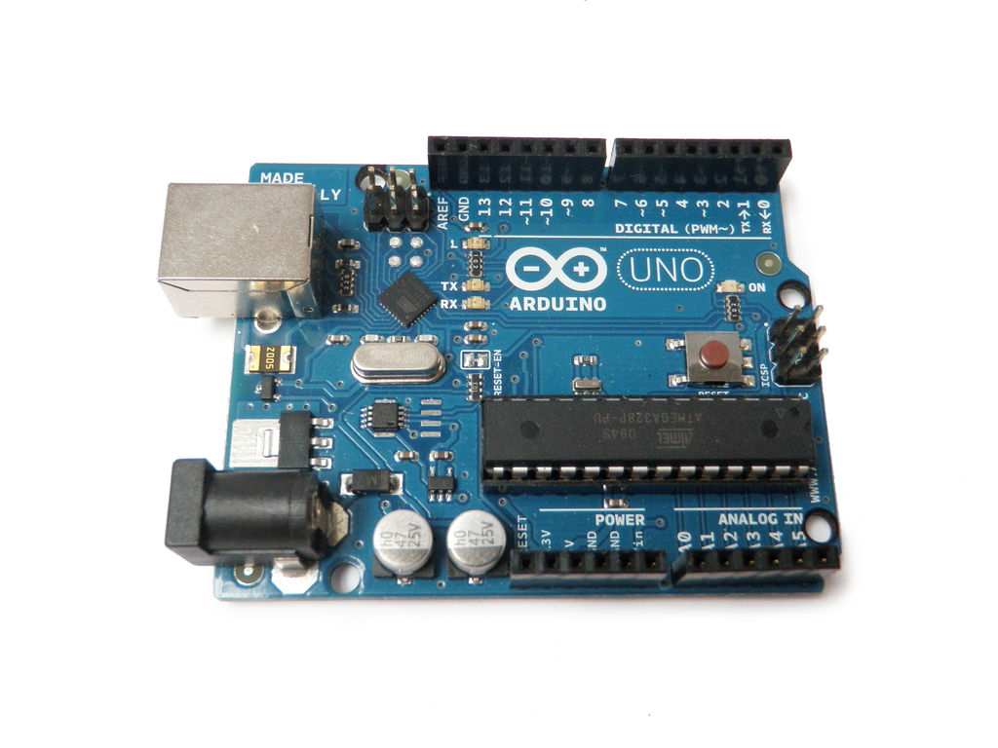

Among many different ways to do a serial communication,
We’ll use:
Microcontroller
Processing, Max/MSP, OpenFrameworks...
p5.serialcontrol

Slide 19
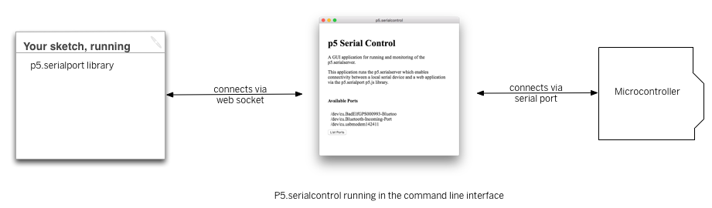
p5.serialcontrol
Notes:
https://github.com/p5-serial/p5.serialcontrol/releases/tag/0.0.6

Slide 20
Getting Ready: Download Software
p5.serialcontrol
Arduino IDE:
arduino.cc/en/Main/Software
Desktop App:
bit.ly/p5-serial-control
P5.js editor:
editor.p5js.org

Slide 21
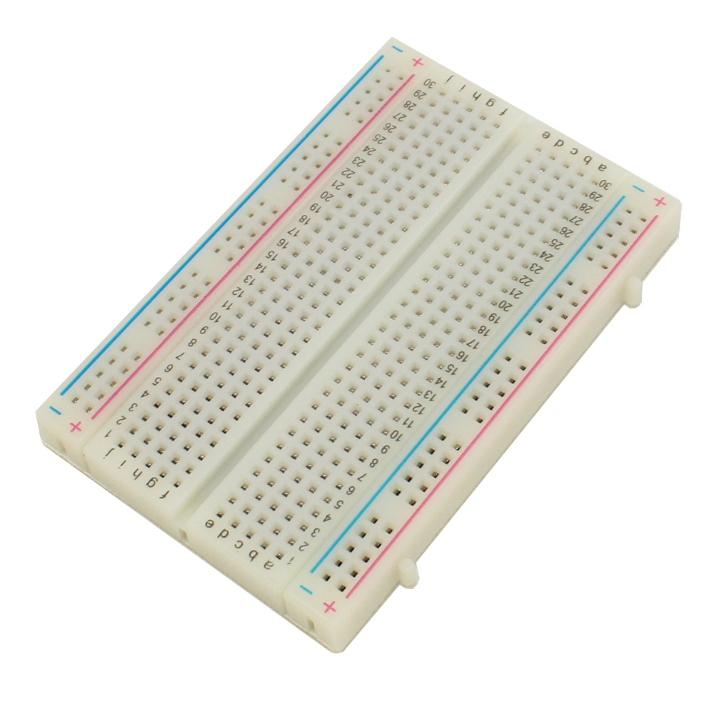
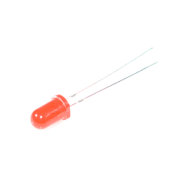
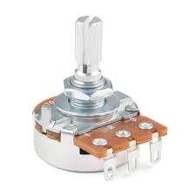
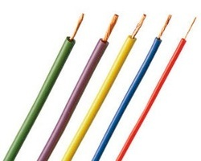
Getting Ready: Get Your Parts

Slide 22
Serial Communication?
Serial Communication between Arduino and p5.js
Arduino to p5.js
p5.js to Arduino
Etch-a-sketch

Slide 23
Arduino to p5.js
Mission:
Use values from a potentiometer to adjust the size of a circle on the screen

Slide 24
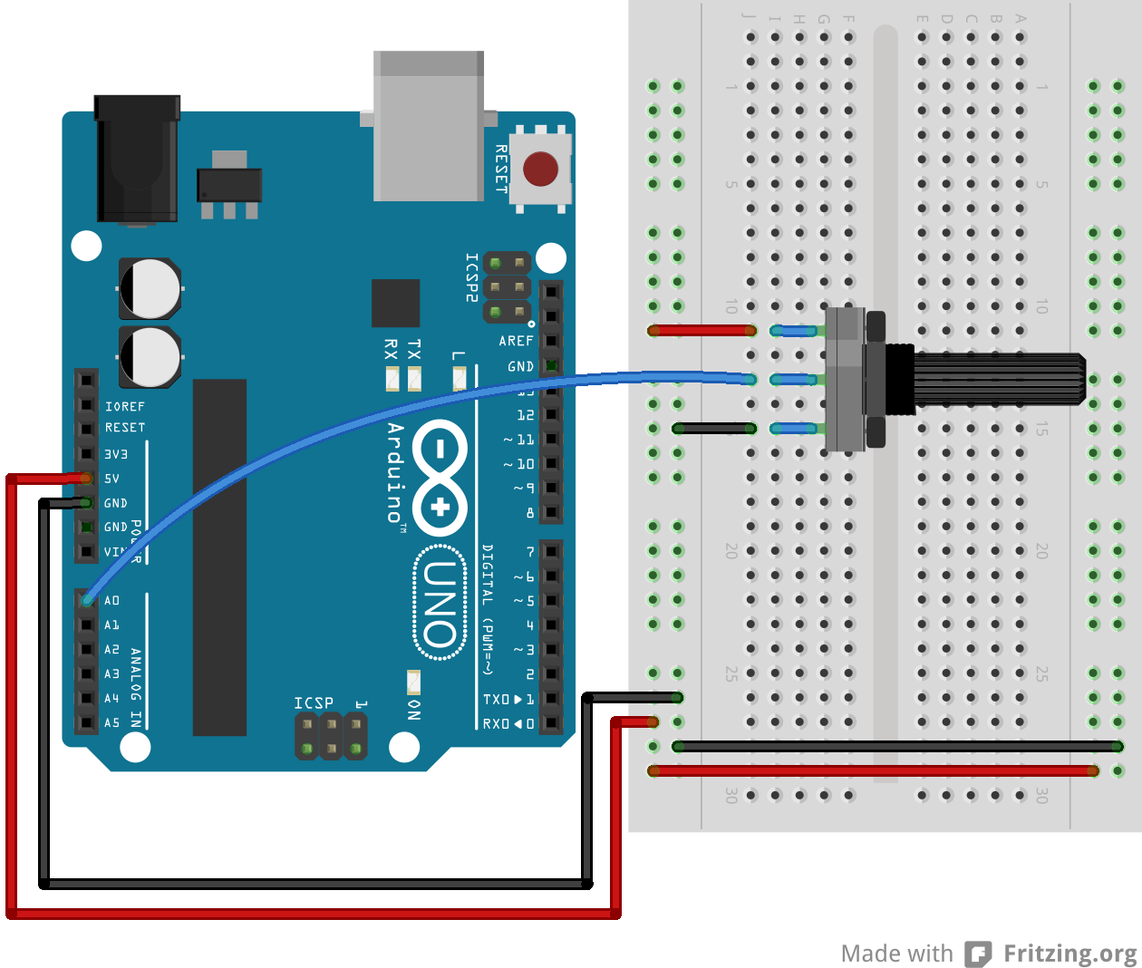
Arduino to p5.js: Wiring
Notes:
https://editor.p5js.org/pyeseul/sketches/EhRQZftZt

Slide 25
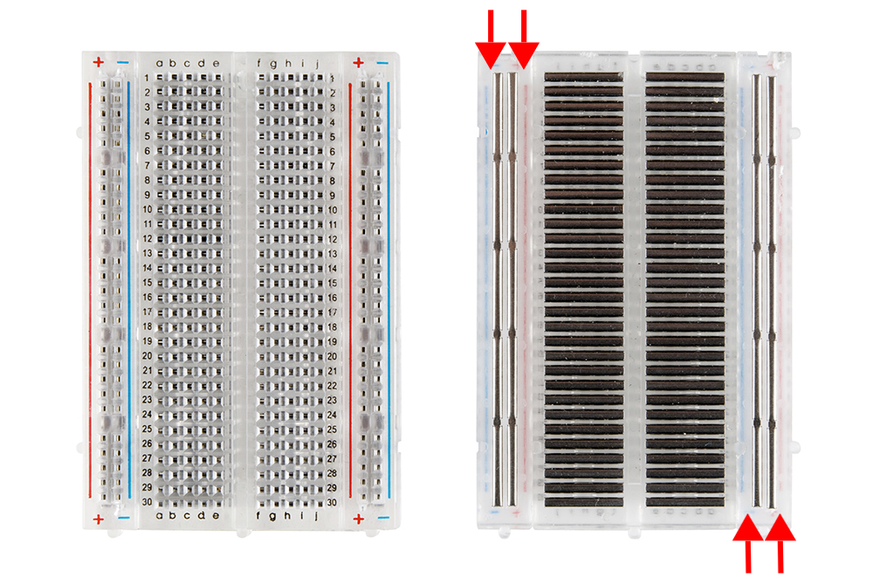

Slide 26
Arduino to p5.js (Binary)
The simplest way when you want to send one sensor value that ranges 0-255
Sending 1byte continuously
No extra parsing needed on the p5.js side
Notes:
Just send the value over and over, and the receiver can read the latest byte to have your whole message.

Slide 27
Arduino to p5.js (Binary)
Sensor Range: 0-1023 (when connecting it to 5V)
→ use “Map” or “/” to fit the 0-255 range on the Arduino side

Slide 28
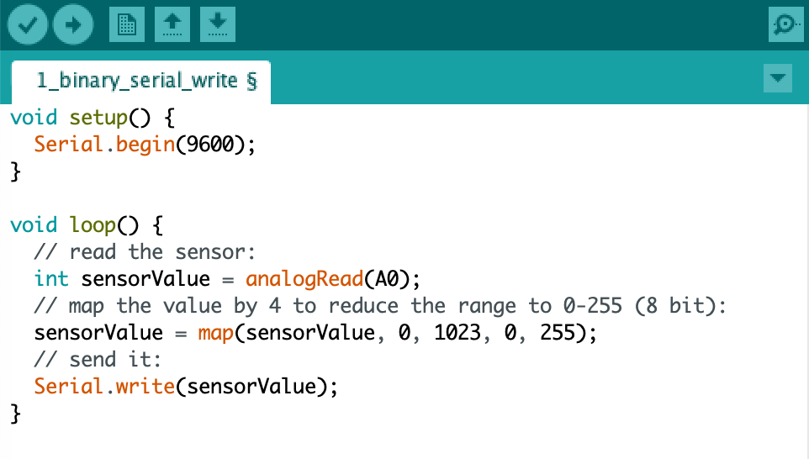
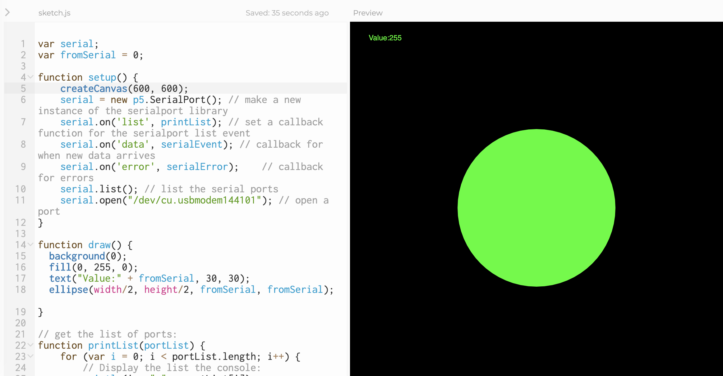
Arduino to p5.js (Binary): Code
Code is found at: bit.ly/arduino-p5-binary
OR
Start from Boilerplate: bit.ly/serial-boiler
Arduino:
P5.js:

Slide 29
Arduino to p5.js (Ascii)
What if,
we want to send a wider range of value?

Slide 30
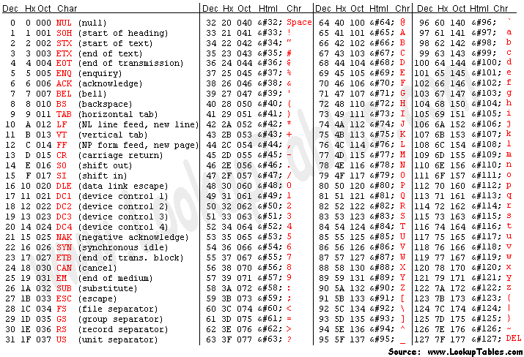
Arduino to p5.js (Ascii)

Slide 31
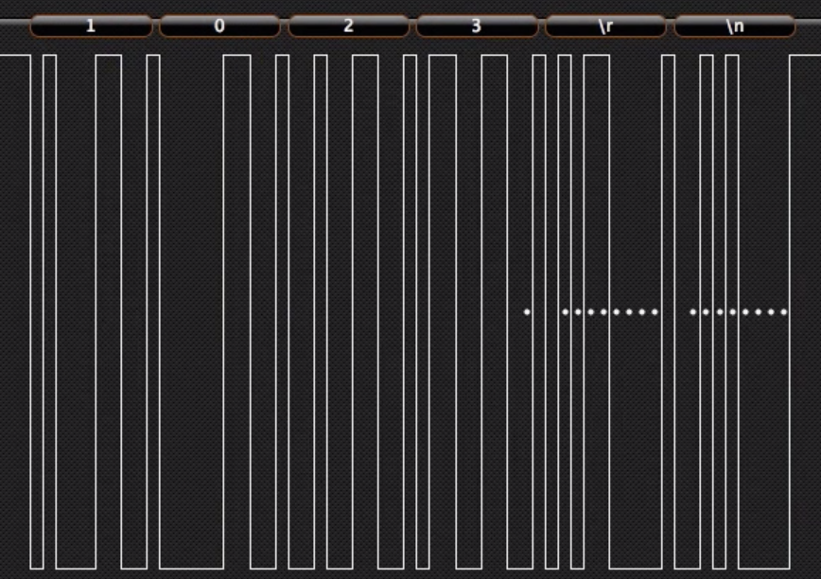
Arduino to p5.js (Ascii)
Decimal

Slide 32
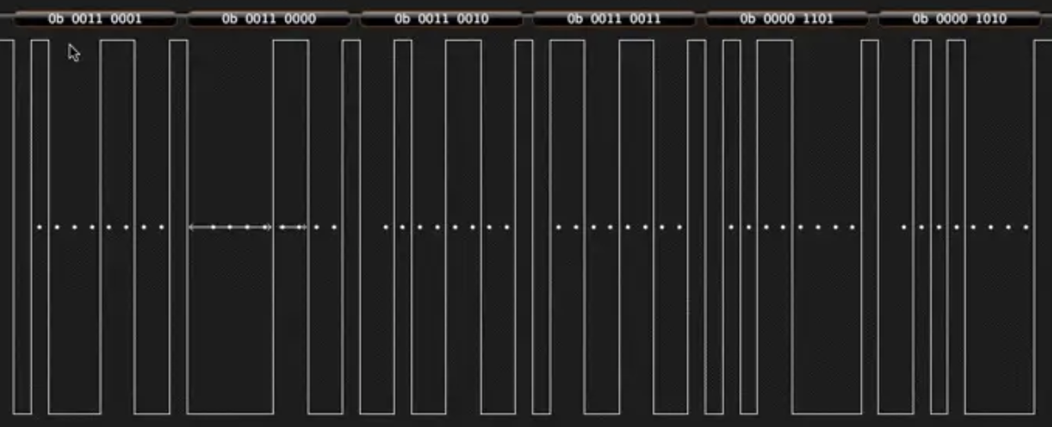
Arduino to p5.js (Ascii)
binary

Slide 33
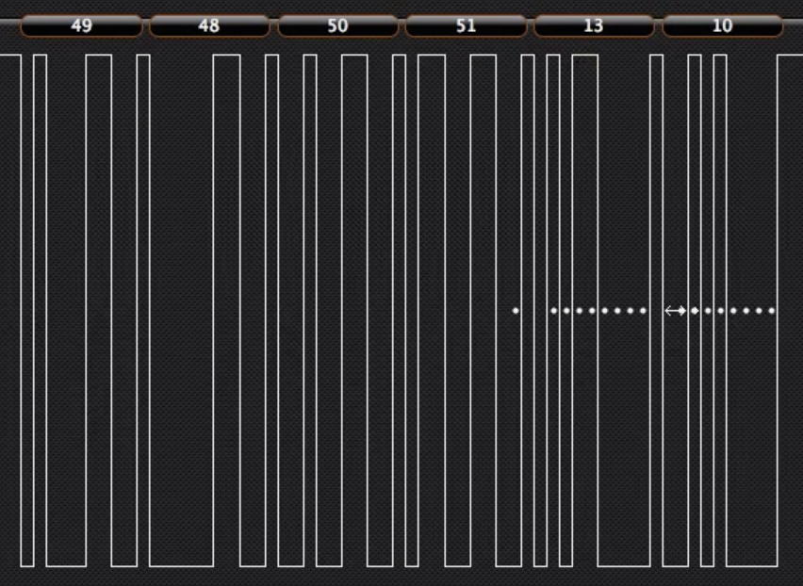
Arduino to p5.js (Ascii)
Ascii

Slide 34
Arduino to p5.js
 | Binary | Ascii
Range: | 0-255 ONLY (< 2⁸ = 1 byte) | Ascii Table
Arduino: | Serial.write() | Serial.println()
p5.js: | serial.read() | serial.readLine() = readStringUntil(‘\r\n’)

Slide 35
Arduino to p5.js (Ascii)
Arduino | Serial.println() instead of Serial.write()
p5.js | serial.readLine() -- read a string from the serial port: check to see that there's actually a string there: if (inString.length > 0 ) { fromSerial = Number(inString); -- convert it to a number: }

Slide 36
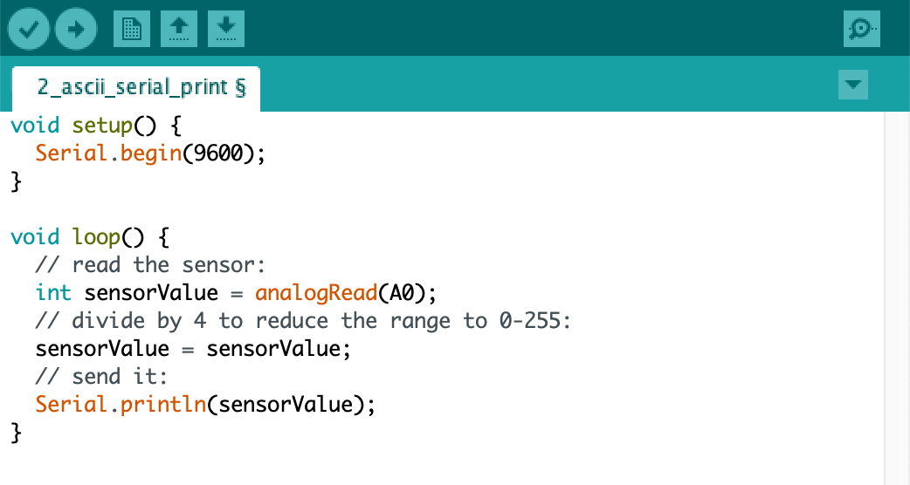
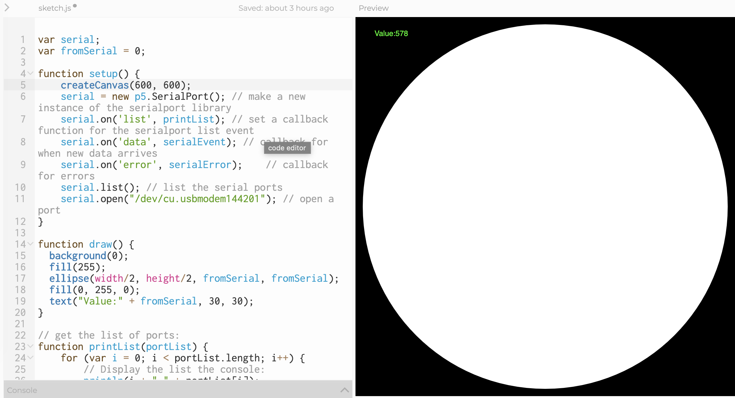
Arduino to p5.js (Ascii): Code
Code is found at: bit.ly/arduino-p5-ascii
Arduino:
P5.js:

Slide 37
Serial Communication?
Serial Communication between Arduino and p5.js
Arduino to p5.js
p5.js to Arduino
Etch-a-sketch

Slide 38
p5.js to Arduino
 | Binary | Ascii
Range: | 0-255 ONLY (< 2⁸ = 1 byte) | Ascii Table
p5.js: | serial.write() | serial.write(valueToSend + ",")
Arduino: | Serial.read() | Serial.parseInt()
Notes:
serial.write(valueToSend + ","); // this adds a comma and turns it into a string

Slide 39
p5.js to Arduino
Mission:
Use mouse position on a sketch to adjust the brightness of an LED

Slide 40
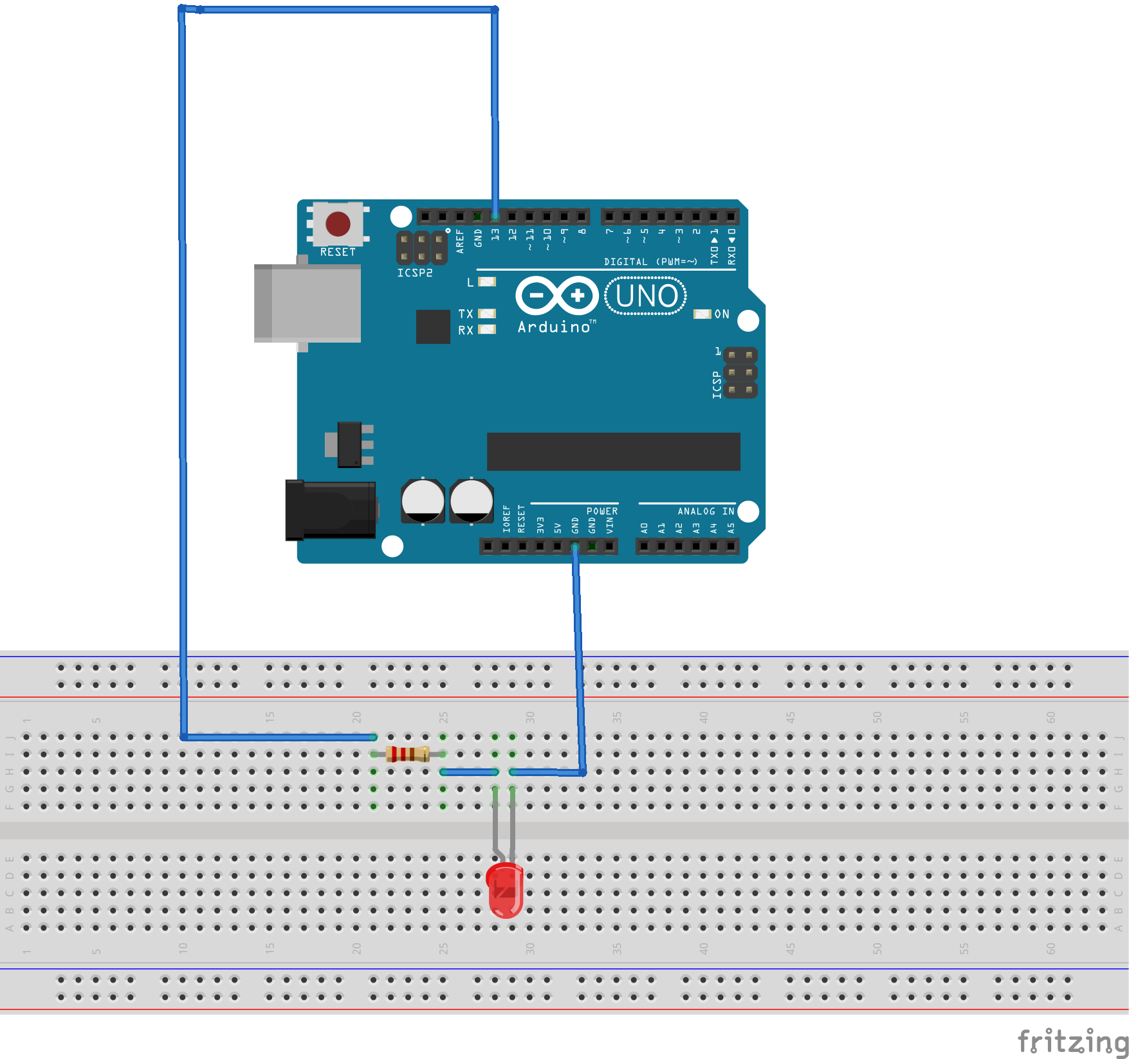
p5.js to Arduino: Wiring
Notes:
https://editor.p5js.org/pyeseul/sketches/EhRQZftZt

Slide 41
p5.js to Arduino (Binary): Code
Code for Arduino and p5.js:
bit.ly/p5-arduino-binary
Notes:
If you’re sending more than one value (and you usually are), then the receiving computer has to know when the message starts and when it ends, and it needs to know how to put the bytes together into a message.

Slide 42
p5.js to Arduino (Ascii): Code
Code for Arduino and p5.js:
bit.ly/arduino-p5-ascii
Notes:
If you’re sending more than one value (and you usually are), then the receiving computer has to know when the message starts and when it ends, and it needs to know how to put the bytes together into a message.

Slide 43
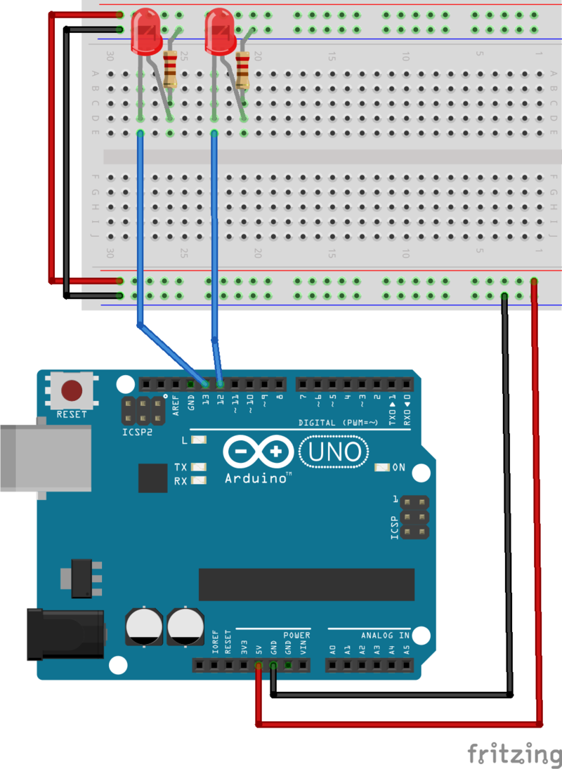
p5.js to Arduino (Multiple Values): Wiring

Slide 44
p5.js to Arduino (Multiple Values): Code
Code for Arduino and p5.js:
bit.ly/arduino-p5-multiple
Notes:
If you’re sending more than one value (and you usually are), then the receiving computer has to know when the message starts and when it ends, and it needs to know how to put the bytes together into a message.

Slide 45
Serial Communication?
Serial Communication between Arduino and p5.js
Arduino to p5.js
p5.js to Arduino
Etch-a-sketch

Slide 46
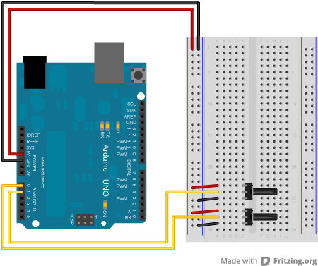
Arduino to p5.js (Multiple Values): Wiring
Notes:
https://editor.p5js.org/pyeseul/sketches/EhRQZftZt

Slide 47
Arduino to p5.js (Multiple Values): Code
Code for Arduino and p5.js: bit.ly/arduino-p5-multiple

Slide 48
More Readings
https://itp.nyu.edu/physcomp/labs/labs-serial-communication/lab-serial-input-to-the-p5-js-ide/
https://itp.nyu.edu/physcomp/labs/labs-serial-communication/lab-serial-output-from-p5-js/

